Slide 1

Cognitive Functions

Slide 2
Cognitive Functions
Attention
Emotion and Feelings
Learning
Memory

Slide 3
Nudge Theory
Understanding of how people think, make decisions, and behave,
Helping people improve their thinking and decisions,
Managing change of all sorts, and
Identifying and modifying existing unhelpful influences on people.
Thaler and Sunstein (2008)
'Nudge: Improving Decisions About Health, Wealth, and Happiness’
Nudge theory is mainly concerned with the design of choices, which influences the decisions we make. Nudge theory proposes that the designing of choices should be based on how people actually think and decide (instinctively and rather irrationally), rather than how leaders and authorities traditionally (and typically incorrectly) believe people think and decide (logically and rationally).

Slide 4
Enforced Change | Nudge Techniques
Instructing a small child to tidy his/her room. | Playing a 'room-tidying' game with the child.
Erecting signs saying 'no littering' and warning of fines. | Improving the availability and visibility of litter bins.
Joining a gym. | Using the stairs.
Counting calories. | Smaller plate.
Weekly food shop budgeting. | Use a basket instead of a trolley.

Slide 5
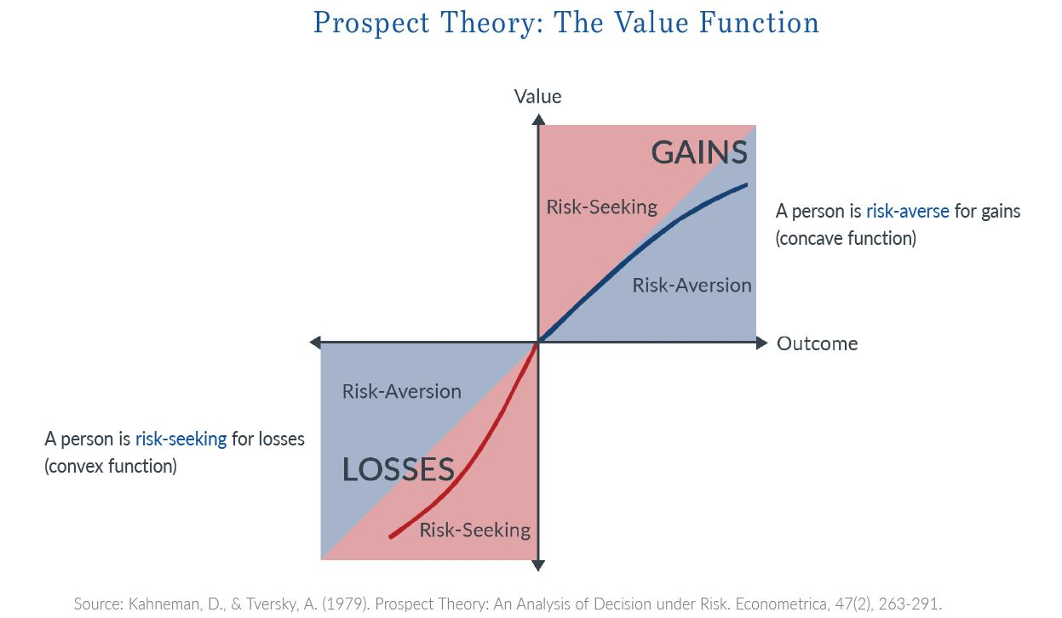

Slide 6
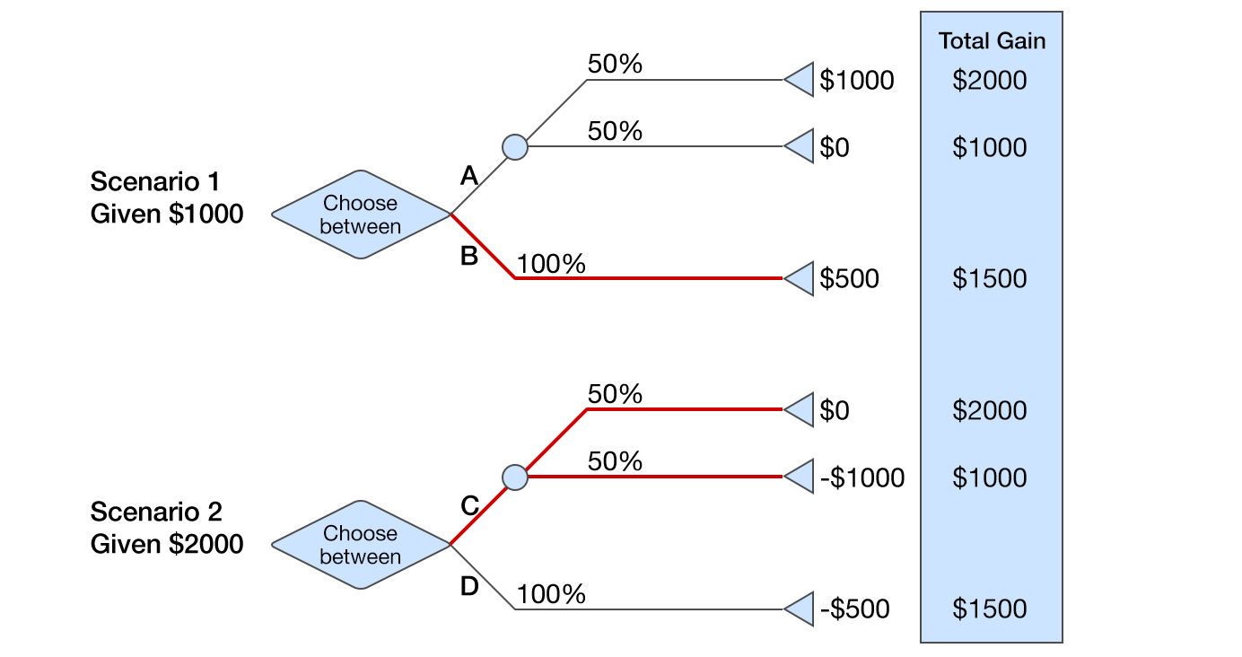
Scenario 1: Participants started with $1000. They then could choose between:
Winning $1000 with a 50% probability (and winning $0 with a 50% probability), or
Getting another $500 for sure.
Scenario 2: Participants started with $2000. They then could choose between:
Losing $1000 with a 50% probability (and losing $0 with a 50% probability), or
Losing $500 for sure.

Slide 7
'Human' | 'Econ'
Automatic system | Reflective system
Uncontrolled | Controlled
Effortless | Effortful
Associative | Deductive
Fast | Slow
Unconscious | Self-aware
Skilled | Rule-following

Slide 8
Additional 'Nudges'
Positioning - moving things, prominence
Limiting - expiry dates, limited stock
Sympathy - ease of adoption, path of least resistance
Accessibility - efficiency of communication, reach, penetration
Likeability - trust, reputation, credibility, honesty, integrity (of 'nudger')
Relevance - fit with audience needs, self-image, situation
Mood-changers - inspiration, passion, flair, intrigue, humour/humor
Fear - thinking driven by risk or threat
Facilitation - helping people to think and decide
Sensory - sounds/music, smells, touch, colour/color

Slide 9
Heuristics
Anchoring and adjustment
Using a known/comparable 'fact' or belief and adjusting it to guess/decide something which is unknown.
The 'comparable' reference is commonly not a good similarity.
Estimates are commonly very inaccurate, resulting in unreliable guesses on which to base a decision.
This thinking may be affected (unhelpfully 'primed') by mass media, misreporting, popular misconception, and myths.
These anchors act as nudges.
Availability
Perceived commonness/familiarity of something produces a perceived popularity or incidence of something, and a basis for trust/credibility.
Representativeness
People refer to personal stereotypes or assumptions in seeking references for unknowns.
Loss aversion
People tend to value something more when they possess it, than if they do not (Thaler and Sunstein suggest that this over-valuation equates to 100% or double)
People (therefore) tend to resist (to a disproportionate degree) losing something they already possess, or exchanging it for something of equal or even greater value.
Framing

Slide 10
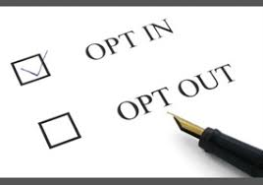
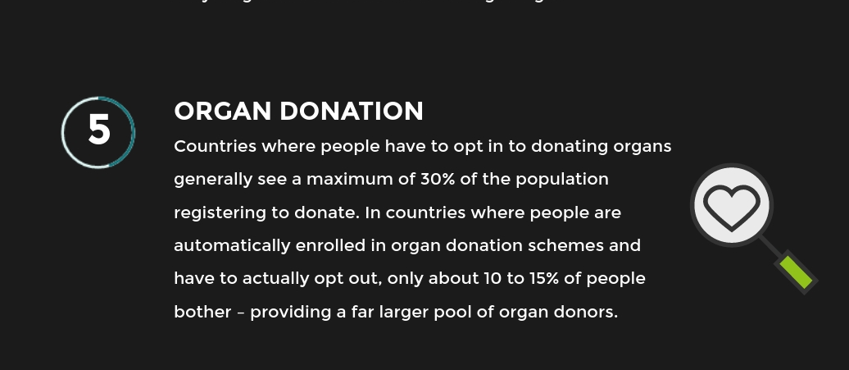
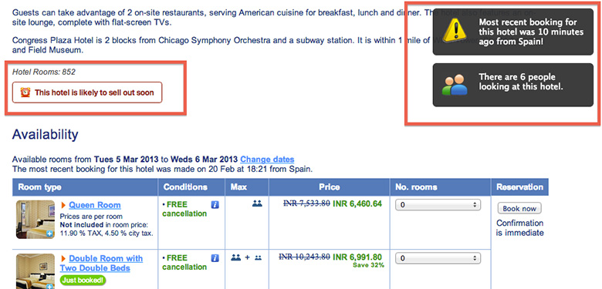

Slide 11
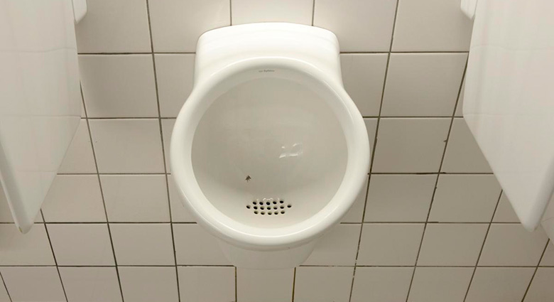
Schiphol airport in Amsterdam wanted to reduce “spills” in the toilets and reduce cleaning costs. To do this, they etched an image of a Fly into each urinal, encouraging men to direct their aim towards the centre.
No fine, no instructions – just a fly to aim at.
The result: an 80% reduction in spillage.

Slide 12
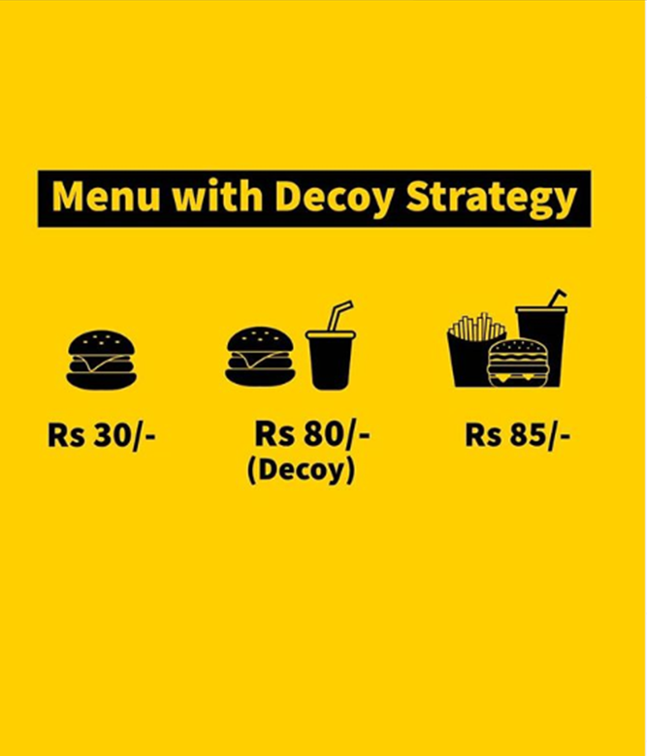

Slide 13
Cognitive Functions
Attention
“Every one knows what attention is. It is the taking possession by the mind, in clear and vivid form, of one out of what seem several simultaneously possible objects or trains of thought. Focalization, concentration, of consciousness are of its essence. It implies withdrawal from some things in order to deal effectively with others, and is a condition which has a real opposite in the confused, dazed, scatter brained state.”
(James 1890/1950, p.403)
A focusing of the mind
Selection of some things on the cost of (many) other objects or trains of thoughts
Selected things become more clear and vivid
Attended items or thoughts are processed more effectively

Slide 14
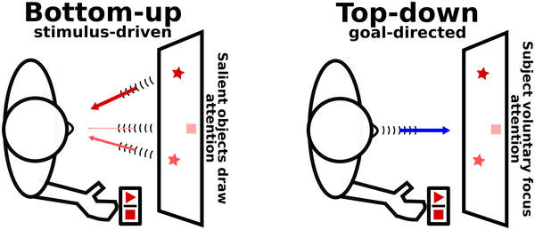

Slide 15
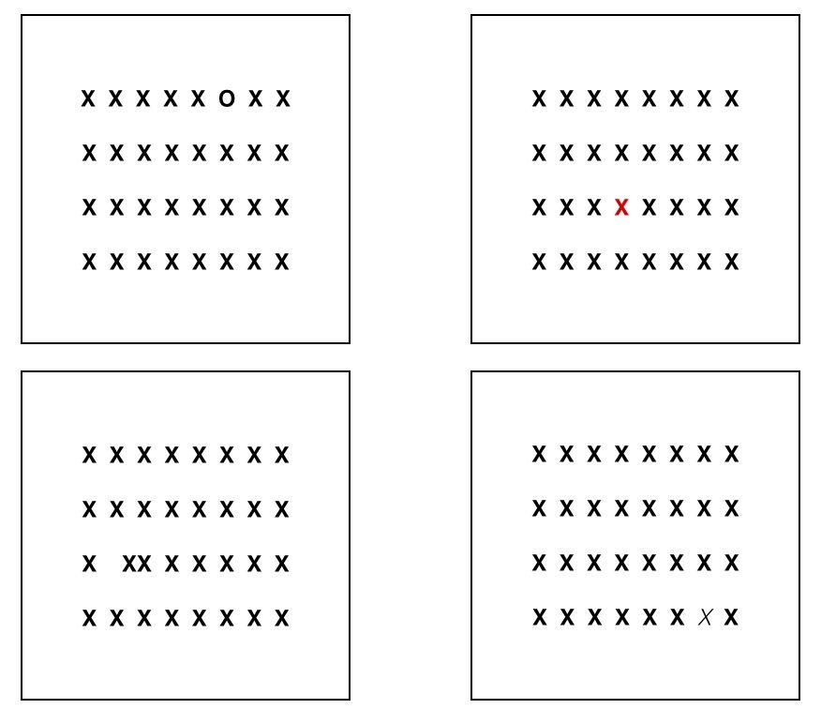
Bottom-up attention
Sensory input can make their way to the mind by sheer force: by being extremely bright, noisy or otherwise unexpected. We call such effects bottom- up, as in when our lower (bottom) senses are stimulated to such an extent that they produce effects higher up in the processing system. In this way, properties of the stimulus itself can attract attention.
Automatic – it happens by itself as a response to particular events
Fast – the response is immediate Non-volitional – it does not require you to wilfully focus your mind

Slide 16
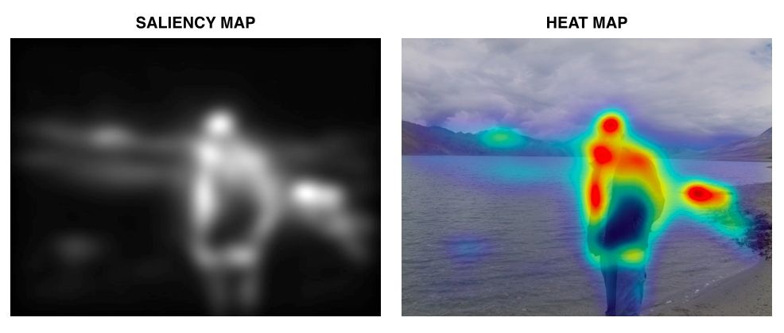
Saliency
Information that is visually salient is detected early on in the visual system and cascaded of this information goes through the primary visual cortex and affects the attention it receives later on by other regions, such as the parietal and frontal cortex. Indeed, these processes have been suggested to create a so- called saliency map in which different features, such as density, angles, contrast, and colour composition, that can be modelled mathematically, allowing for automatic analysis and prediction of what the eyes will automatically fixate on (Itti 2000).

Slide 17
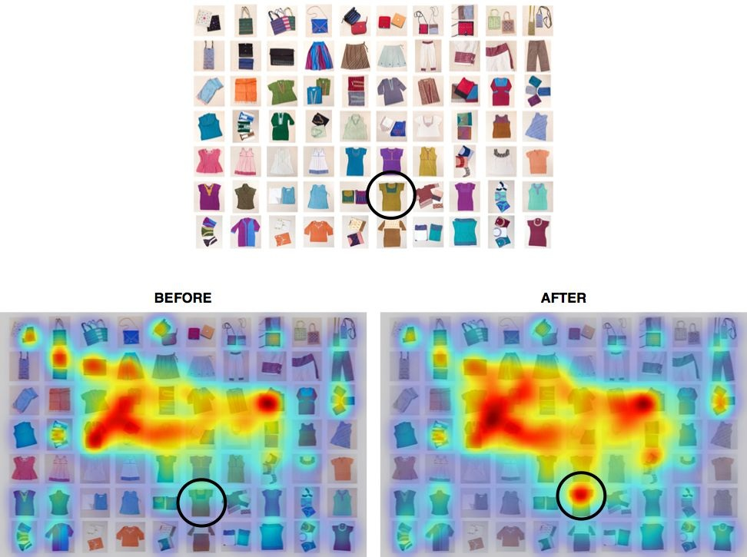

Slide 20
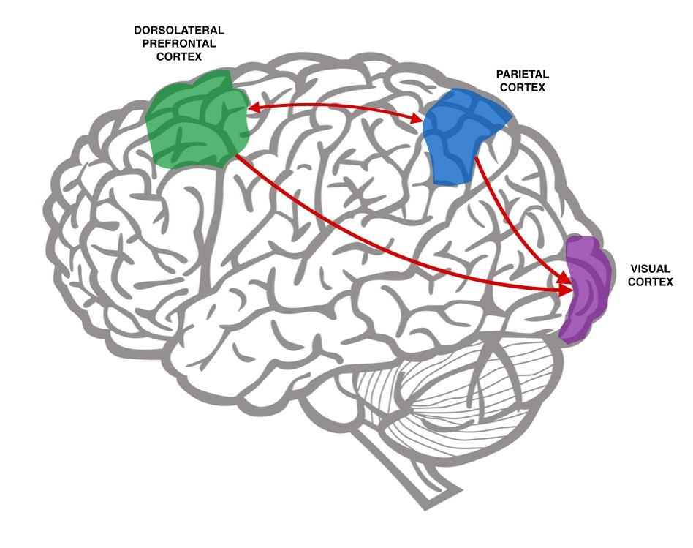
Top-Down Attention
Controlled – attention is not automatic but requires active selection and mobilisation
Slow – the response needs build-up
Volitional – it requires that a wilful focusing of your mind

Slide 21
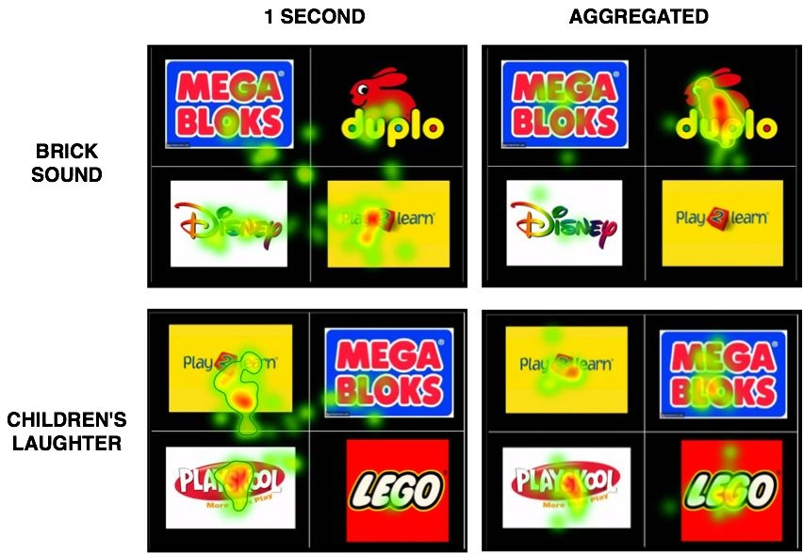
Effects of immediate and focused attention on relating a sound to toy brands. As can be seen, eye fixations during the first second of brand presentation were different from what people ended looking most at.

Slide 22
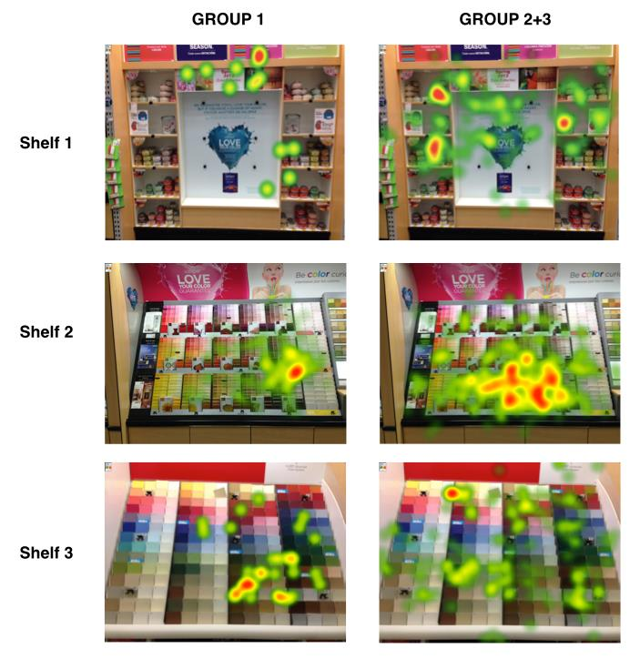
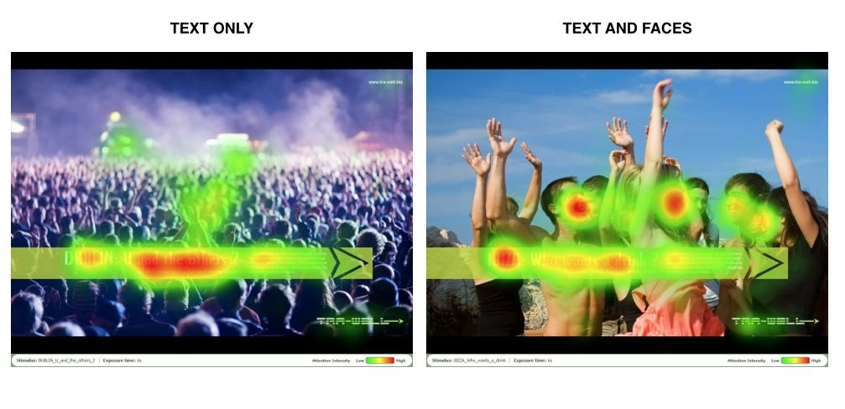
Other Attentional Factors
Effects of prior ad exposure on visual attention. Prior exposure to the brand advertisement increased the time spent on exploring this brand ́s shelves as well as their interest in the advertised brand ́s products. Significant differences were found on shelves 1 and 2, which contained Brand A products, while no differences were found for shelves without Brand A products, such as Shelf 3.

Slide 23
How to Attract Attention
Make it salient!
Visual saliency is key: work on increasing brightness, contrast, density and other features that increases the visual saliency of an object
Less is more!
Making something more salient also means making everything else less salient. In the visual domain, try to dim other visual stimuli, make them darker, more diffuse or anything that can help make the object at hand stand out. A single item on a plain background is an insurance that it will be seen.
Convince to search
The best case is where consumers are actively pursuing information about your product, and actively trying to purchase it.

Slide 24
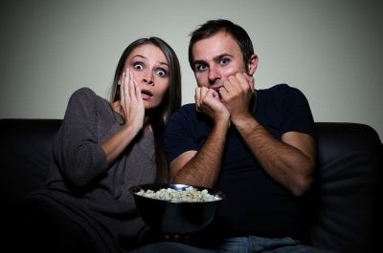
Emotion
EMOTIONS – an organism’s expression of an inner/bodily state; a bodily response to an event with a mechanical, stimulus-response basis. It is typically occurring before or without consciousness.
FEELINGS – an organism’s (person) experience of being in a certain emotional state. It is always associated with consciousness / experience. It is “introspective”, in the sense that it is something we can look at and explore, as in “Today I woke up feeling happy”.

Slide 25
Dimensions of emotions
Arousal – Bodily responses of general excitement to “relevant” cues, ranging from low to high.
Valence – Emotional responses indicating the relative hedonic evaluation, ranging from positive – neutral – negative.
GroeppelKlein (2005)
An experimental store with a richer store environment, including multiple products and sales materials, lead to a higher overall arousal compared to a less stimulating control store
Increased in-store arousal was associated with subsequent reports of “joy”
When comparing those that buy products with non-buyers, buyers demonstrate a higher POS arousal

Slide 26
Frontal Asymmetry
Higher engagement of the left relative to the right frontal brain is related to positive feelings
Recent evidence suggests that the asymmetric engagement of the frontal lobe is more related to what has been coined approach-avoidance behaviour.
Aggression, a negative emotion but with “approach” properties, was associated with a stronger left than right activation (HarmonJones 2010)
If indeed the left-right asymmetry index was related to emotional valence, then aggression should show a stronger right than left activity. If the index was a measure of approach vs avoidance motivation, then it would show stronger left than right engagement. Since the latter was found, the frontal asymmetry index has been coined an index of approach vs avoidance, or a motivation index.

Slide 27
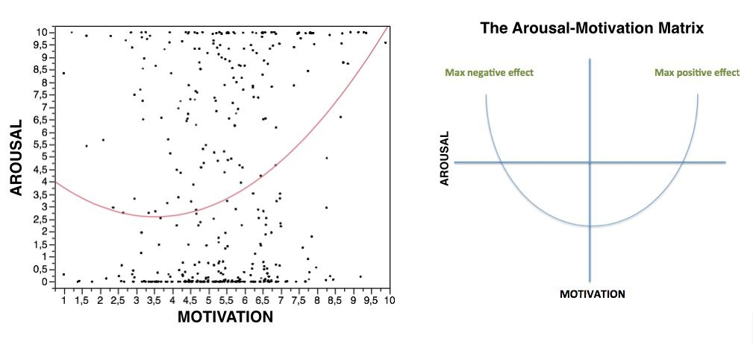
The Arousal–Motivation Matrix

Slide 28
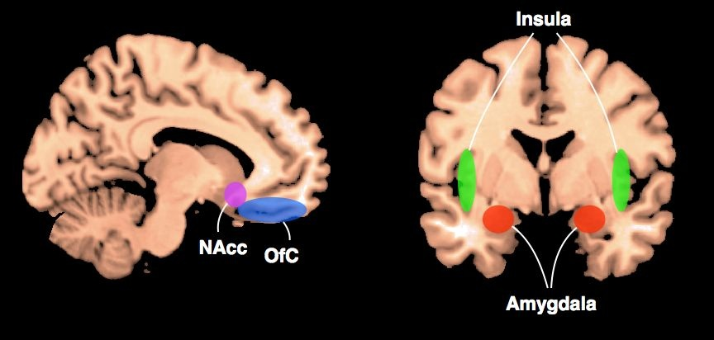
Emotional brain regions
Regions such as the amygdala have long been known to be involved in negative emotions such as fear and stress; the insula has been shown to be involved in disgust. Conversely, the medial orbitofrontal cortex has been shown to be involved in enjoyment, and the nucleus accumbens (NAcc) has been shown to be involved in desire and approach behaviour.

Slide 29
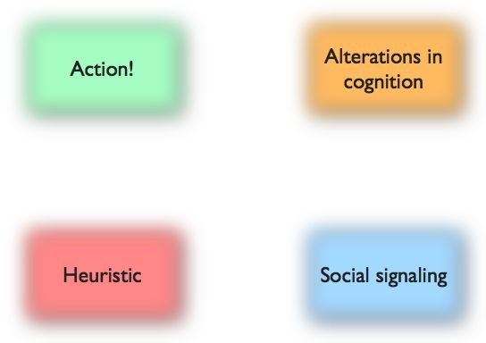
What Emotions Do?

Slide 30
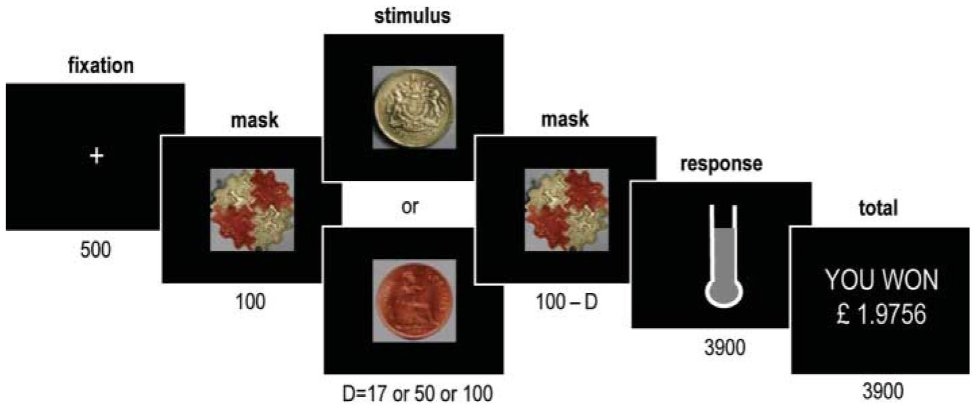
Action
Emotions can make us run away, fight back, approach something positive, or allow us to relax.
ventromedial prefrontal cortex is highly implicated in connecting emotional responses to behaviour – patients with lesions to this region can show emotional responses, but are unable to make use of those emotions in guiding their behaviour (Bechara 2000; Northoff 2006)
In a study by Mathias Pessiglione (Pessiglione 2007), it was found that the size of a subliminally presented monetary reward was associated with the strength at which people responded during a choice task.

Slide 31
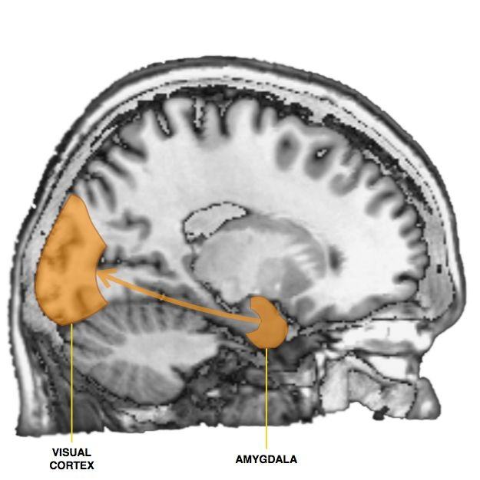
Alterations in cognition
Sabatinelli and colleagues (Sabatinelli 2005) studied how arousing stimuli could engage the primary sensory cortices. Here, the researchers found that the amygdala and inferior temporal cortex were closely co-activated, suggesting that the amygdala can modulate the engagement of earlier stage processes. Similar findings have been reported by other researchers looking at even earlier visual processes, including the primary visual cortex (Serences 2008).
mere exposure effect is the phenomenon where a stimulus that is repeated leads to a more positive evaluation, compared to comparable stimuli that are not seen multiple times (Zajonc 2001; Zajonc 1968; Falkenbach 2013)

Slide 32
Heuristics and Social Signalling
emotions operate as a guiding principle for such shortcuts. If the immediate emotional responses evaluate something as threatening, our choices will be affected accordingly, even in the complete absence of conscious processing
Language – communicated as text or speech, what we say is ultimately a statement of emotions and feelings, such as “I feel sad”
Intonation – we use our voices to underline or even contradict war we say. Even shouts and cries that have no language contents per se, can function as meaningful emotional expressions
Gestures – the way we use our hands and body can be used to appear threatening, angry, happy or sad
Blushing – related to facial expressions, but can work as a powerful social cue

Slide 33
